Slide 3

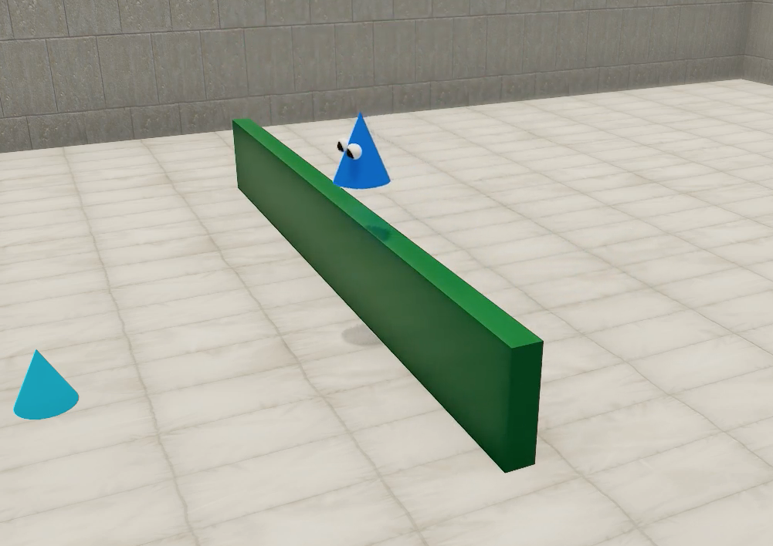
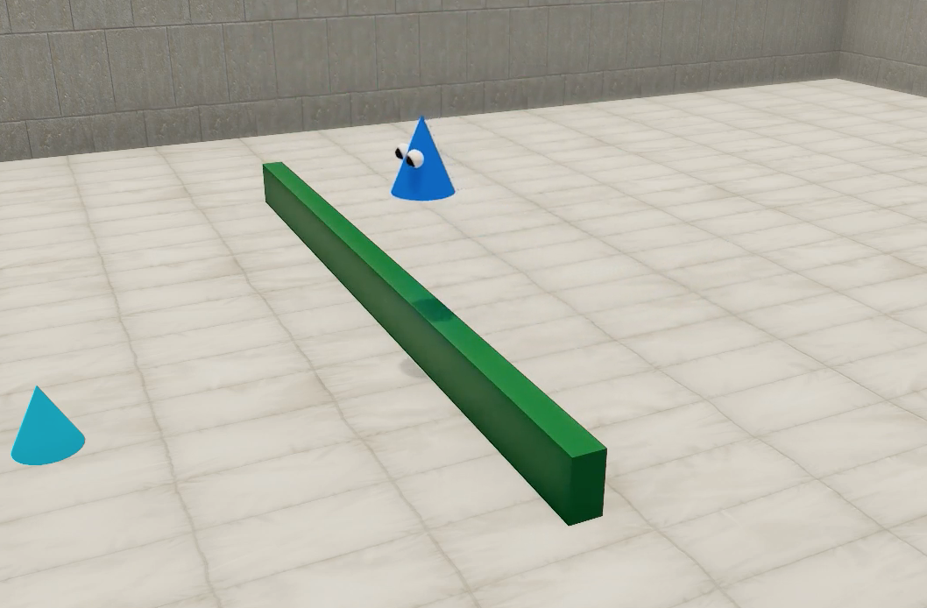


Repeats
Repeats
1-MIN TRIAL
YOUR TURN
ca. 1 minute
Notes:
Scenarios: cliff jump, cliff test on bridge, barrier jump, barrier go around
Reach out to shari about instructions for parents - ( )
Select one of four scene orders:
1,2,3,4
4,3,2,1
2,4,1,3
3,1,4,2

Slide 4

Repeats
Repeats
1-MIN TRIAL
YOUR TURN
ca. 1 minute
?
In this study, we will ask you to stop this trial when your child has looked away from this scene.
Notes:
Scenarios: cliff jump, cliff test on bridge, barrier jump, barrier go around
Reach out to shari about instructions for parents - ( )
Select one of four scene orders:
1,2,3,4
4,3,2,1
2,4,1,3
3,1,4,2

Slide 5

10s
X 5
10s
X 5
10s
X 5
10s
X 5
Scene 1
Scene 2
Scene 3
Scene 4
10s
X 5
10s
X 5
optional
Scene 5
Scene 6
Notes:
Scenarios: cliff jump, cliff test on bridge, barrier jump, barrier go around
Reach out to shari about instructions for parents - ( )
Select one of four scene orders:
1,2,3,4
4,3,2,1
2,4,1,3
3,1,4,2

Slide 6

TRIAL 1
TRIAL 2
Repeats
Repeats
attention getter
attention getter
Trial 1
Your turn!
At the beginning of every “block”, your child will see a rotating star with some sound. We call this the ’attention getter’, because it typically helps us orient babies towards the screen at the beginning of each trial. This marks the beginning of trial 1.
ca. 1 minute
You decide! (max. 60 seconds)
Then, we’ll show some little creature approach an object. This video will repeat for about a minute.
Then, in the second trial, your child will see another attention getter. This trial is marked ‘Your turn!’ to mark the onset of Trial 2.
Unlike trial 1, trial 2 is controlled by you, the parent. We’ll ask you to help us decide when to stop this trial, based on your child’s behavior. More on this later.
We will show different version of Trial 1 and Trial 2 together, for four times. After the fourth time,
we’ll ask whether you want to continue for two completely optional trials, depending on how you and your child feel then. The whole study will take about 6-9 minutes.*
* Though of course you can pause (press p) or stop press esc-key) the study at any point.
Notes:
Scenarios: cliff jump, cliff test on bridge, barrier jump, barrier go around
Reach out to shari about instructions for parents - ( )
Select one of four scene orders:
1,2,3,4
4,3,2,1
2,4,1,3
3,1,4,2

Slide 7
Plan

Slide 8
No parent control during block method
TRIAL 1
Repeats
TRIAL 2
Repeats
attention getter
attention getter
Trial 1
YOUR TURN
ca. 1 minute
You decide! (max. 60 seconds)

Slide 9

Block method
TRIAL 1
Repeats
TRIAL 2
Repeats
attention getter
attention getter
approx 1 minute
approx. 1 minute
BLOCK
Total: 4 regular blocks + 2 optional blocks
Notes:
Scenarios: cliff jump, cliff test on bridge, barrier jump, barrier go around
Reach out to shari about instructions for parents - ( )
Select one of four scene orders:
1,2,3,4
4,3,2,1
2,4,1,3
3,1,4,2

Slide 10
SESSION A instructions

Slide 11



Repeats
attention getter
OR
45 seconds
ONE TRIAL
* you can pause (press “p”) or stop (press esc-key) the study at any point.
Total: 8 trials
(+ 4 optional trials)
= 7 - 10 minutes *
Notes:
Here’s a brief overview of what will happen during the study. [CLICK]
At the beginning of every trial, your child will see an exciting stimulus, like a rotating or pulsing star, which we call the ‘attention-getter’, because we use it to get your child’s attention. [CLICK]
Then, we will show a video of an animated creature reach another object, like you see here. This video will repeat for about 45 seconds. [CLICK]
These two videos, the attention getter and the video of the animated creature, together form one trial. We’ll have a total of eight trials. We’ll ask you after that whether you and your child are up for another four trials, depending on how you two are feeling. [CLICK]
In either case, the experiment should take somewhere between 7 and 10 minutes. [CLICK]
Of course you can pause by pressing the “p” key on your keyboard or stop the experiment by pressing the escape key at any time.

Slide 12
SESSION B instructions

Slide 13
Repeats
attention getter
OR
until your child looks away for three seconds
in a row (max. 45 sec)
ONE TRIAL
* you can pause (press “p”) or stop (press esc-key) the study at any point.
Total: about 10-14 trials
(+ 2 optional trials)
= 7 - 10 minutes *
Notes:
Here’s a brief overview of what will happen during the study. [CLICK]
At the beginning of every trial, your child will see an exciting rotating or pulsing star, which we call the ‘attention-getter’, because we use it to get your child’s attention. [CLICK]
Then, we will show a video of an animated creature reaching another object, like you see here. This video will repeat until your child looks away for three seconds in a row, and we’ll give you more instructions in just a bit on how to indicate when your child has looked away. If your child hasn’t looked away for 3 seconds during the entire 45 second trial, the video will end automatically. [CLICK]
These two videos, the attention getter and the video of the animated creature, together form one trial.
We’ll have a total of about 10-14 trials. We’ll ask you after that whether you and your child are up for another two trials, depending on how you two are feeling. [CLICK]
In either case, the experiment should take somewhere between 7 and 10 minutes. [CLICK]
Of course you can pause by pressing the “p” key on your keyboard or stop the experiment by pressing the escape key at any time.

Slide 14
SESSION B instructions with single attngetter

Slide 15
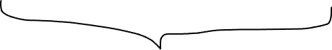
Repeats
attention getter
45 seconds
ONE TRIAL
Total: 8 trials
(+ 4 optional trials)
= 7 - 10 minutes
* you can pause (press “p”) or stop (press esc-key) the study at any point.
Notes:
Here’s a brief overview of what will happen during the study. [CLICK]
At the beginning of every trial, your child will see an exciting stimulus, like a rotating or pulsing star, which we call the ‘attention-getter’, because we use it to get your child’s attention. [CLICK]
Then, we will show a video of an animated creature reach another object, like you see here. This video will repeat for about 45 seconds. [CLICK]
These two videos, the attention getter and the video of the animated creature, together form one trial. We’ll have a total of eight trials. We’ll ask you after that whether you and your child are up for another four trials, depending on how you two are feeling. [CLICK]
In either case, the experiment should take somewhere between 7 and 10 minutes. [CLICK]
Of course you can pause by pressing the “p” key on your keyboard or stop the experiment by pressing the escape key at any time.

Slide 16
Shari replication

Slide 17

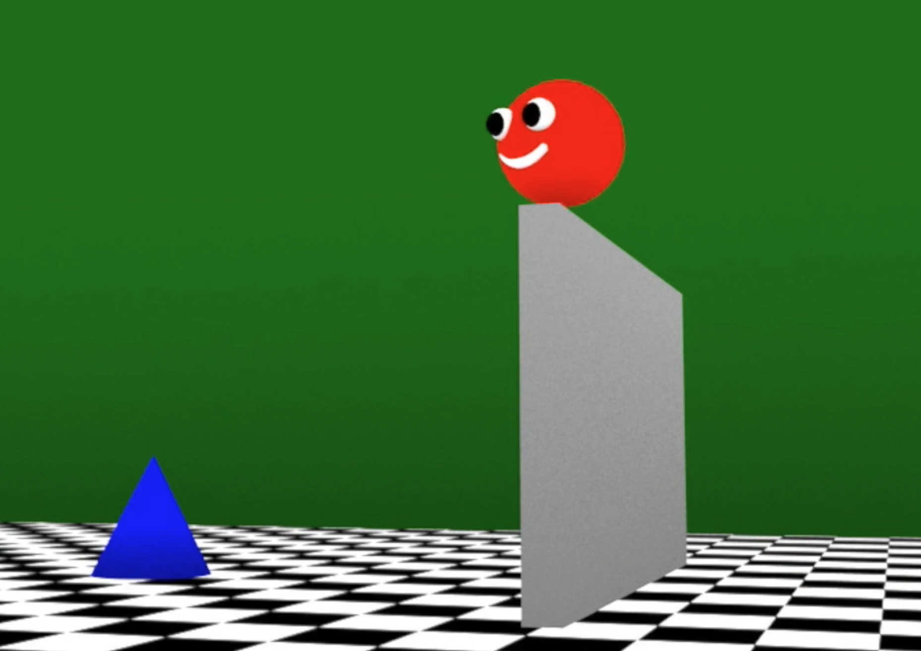

attention getter
Repeats
until your child looks away for three seconds
in a row (max. 60 sec)
ONE TRIAL
you can pause (press “p”) or stop (press esc-key) the study at any point.
Total: about 10 trials
= 5 - 7 minutes
Notes:
Here’s a brief overview of what will happen during the study. [CLICK]
At the beginning of every trial, your child will see an exciting pulsing star, which we call the ‘attention-getter’, because we use it to get your child’s attention. [CLICK]
Then, we will show a video of an animated creature reaching another object, like you see here. This video will repeat until your child looks away for three seconds in a row, and we’ll give you more instructions in just a bit on how to indicate when your child has looked away. If your child hasn’t looked away for 3 seconds during the entire 60 second trial, the video will end automatically. [CLICK]
These two videos, the attention getter and the video of the animated creature, together form one trial.
We’ll have a total of 10 trials. We’ll ask you after that whether you and your child are up for another two trials, depending on how you two are feeling. [CLICK]
In either case, the experiment should take somewhere around 5 to 7. [CLICK]
Of course you can pause by pressing the “p” key on your keyboard or stop the experiment by pressing the escape key at any time.

Slide 18
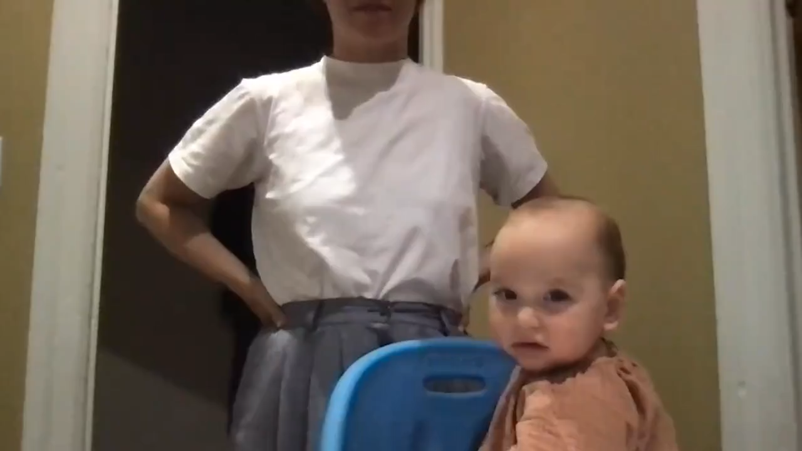
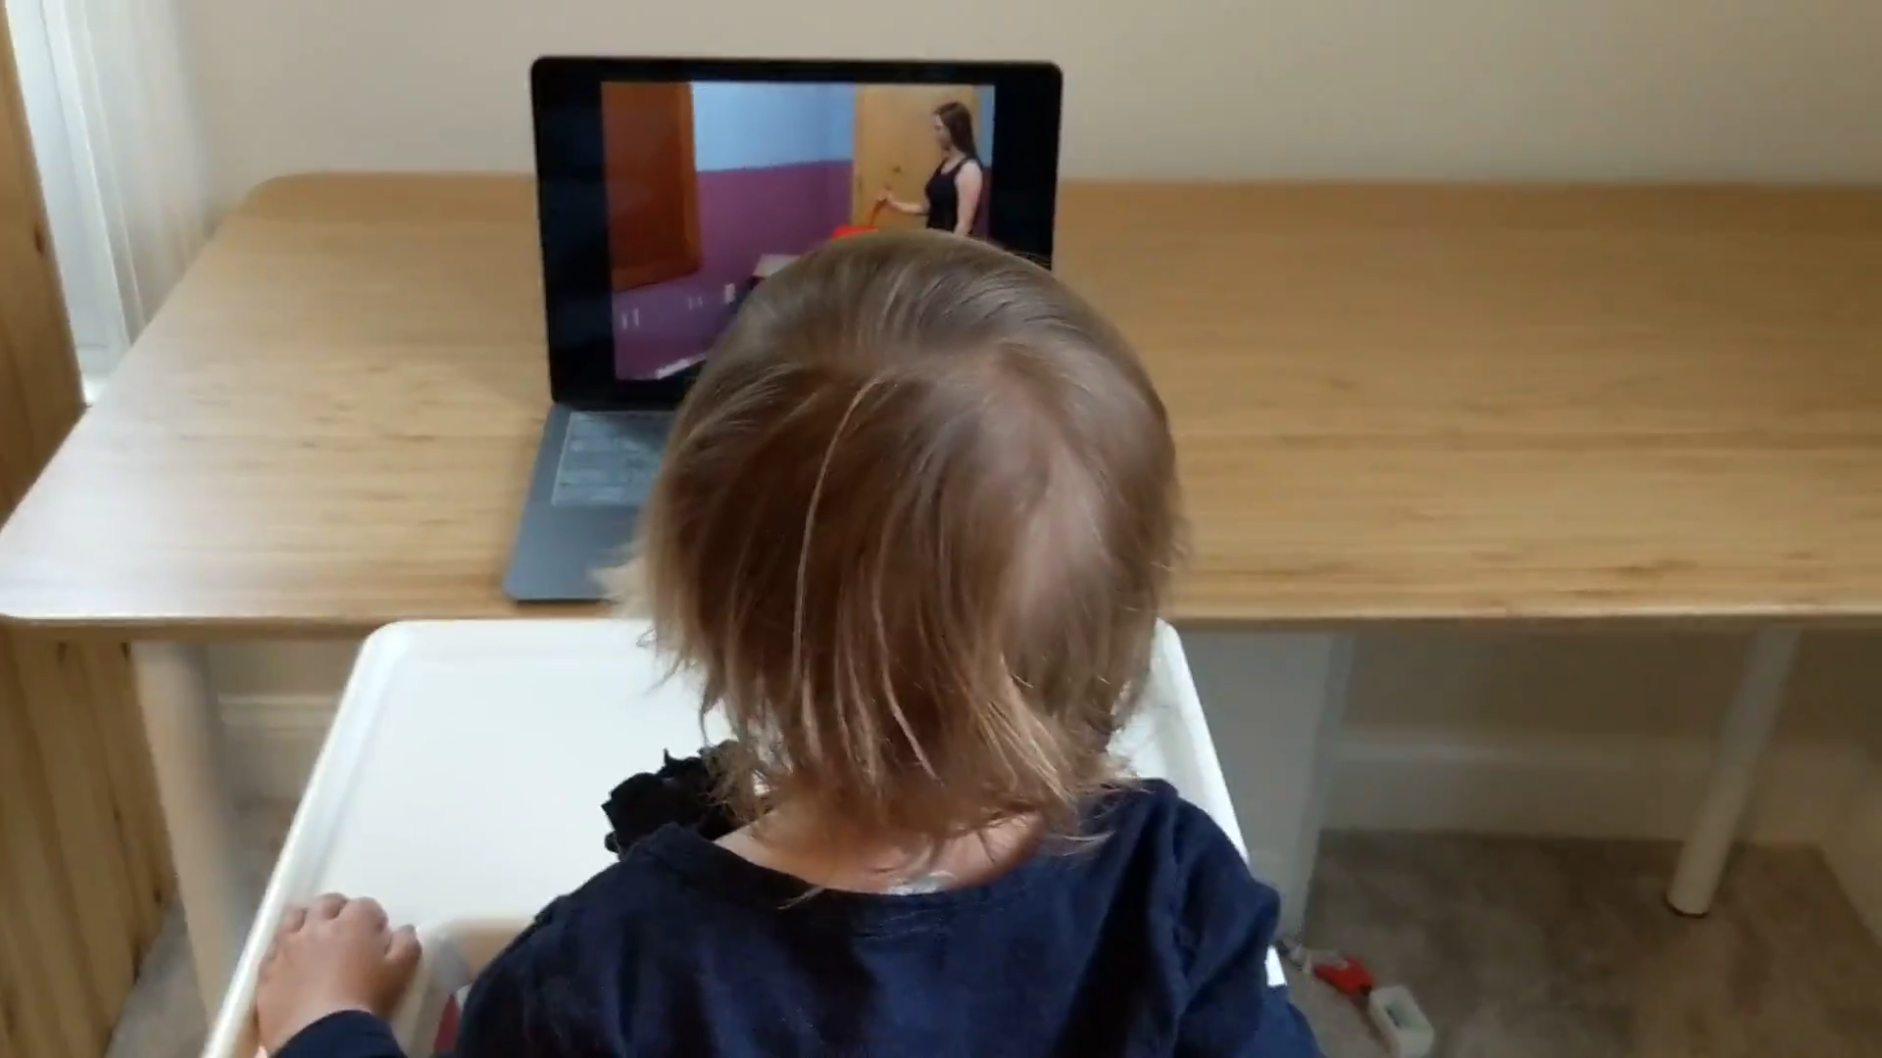
Parent control instructions
Notes:
Ask shari about if she counts up LT until crierion or take

Slide 19







Compare to
Classic method
Block method
Fam
exp
surp
parent-controlled habituation
optional
COMPARE
10s
X 5
10s
X 5
10s
X 5
10s
X 5
Scene 1
Scene 2
Scene 3
Scene 4
10s
X 5
10s
X 5
optional
Scene 1
Scene 2
Notes:
Scenarios: cliff jump, cliff test on bridge, barrier jump, barrier go around
Reach out to shari about instructions for parents - ( )
Select one of four scene orders:
1,2,3,4
4,3,2,1
2,4,1,3
3,1,4,2

Slide 20
Compare to
Classic method
Block method
Fam
exp
surp
parent-controlled habituation
optional
COMPARE
10s
X 5
10s
X 5
10s
X 5
10s
X 5
Scene 1
Scene 2
Scene 3
Scene 4
10s
X 5
10s
X 5
optional
Scene 1
Scene 2
Notes:
Scenarios: cliff jump, cliff test on bridge, barrier jump, barrier go around
Reach out to shari about instructions for parents - ( )
Select one of four scene orders:
1,2,3,4
4,3,2,1
2,4,1,3
3,1,4,2

Slide 21
Compare to
Classic method
Fam
exp
surp
parent-controlled habituation
Notes:
Scenarios: cliff jump, cliff test on bridge, barrier jump, barrier go around
Reach out to shari about instructions for parents - ( )
Select one of four scene orders:
1,2,3,4
4,3,2,1
2,4,1,3
3,1,4,2

Slide 22
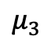
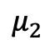
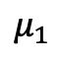
Compare to
Classic method
Fam
exp
surp
parent-controlled habituation
$$μ_{1}$$
$$μ_{2}$$
Max.60s
$$μ_{3}$$
Notes:
Scenarios: cliff jump, cliff test on bridge, barrier jump, barrier go around
Reach out to shari about instructions for parents - ( )
Select one of four scene orders:
1,2,3,4
4,3,2,1
2,4,1,3
3,1,4,2

Slide 23
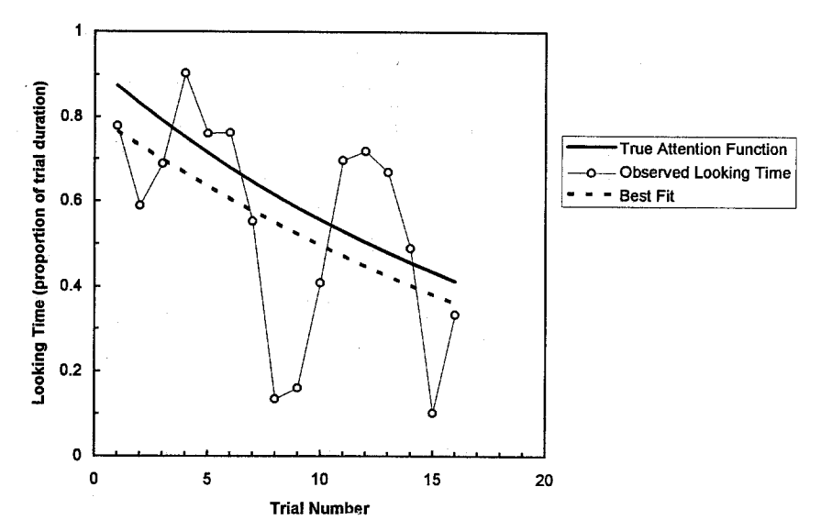
Compare to
Classic method
Fam
exp
surp
parent-controlled habituation
“Measuring Habituation in Infants: An Approach Using Regression Analysis”
Ashmead & Davis, 1996
Notes:
Scenarios: cliff jump, cliff test on bridge, barrier jump, barrier go around
Reach out to shari about instructions for parents - ( )
Select one of four scene orders:
1,2,3,4
4,3,2,1
2,4,1,3
3,1,4,2

Slide 24
Compare to
Classic method
Fam
exp
surp
parent-controlled habituation
How to pre-register analysis of non-habituated kids? (Oakes: exclude) – Decision: report how many kids didn’t habituate, do ‘multiverse’: when comparing effect sizes between block & classic: check what happens when we exclude non-habituated kids and include everbody
Notes:
Scenarios: cliff jump, cliff test on bridge, barrier jump, barrier go around
Reach out to shari about instructions for parents - ( )
Select one of four scene orders:
1,2,3,4
4,3,2,1
2,4,1,3
3,1,4,2

Slide 25
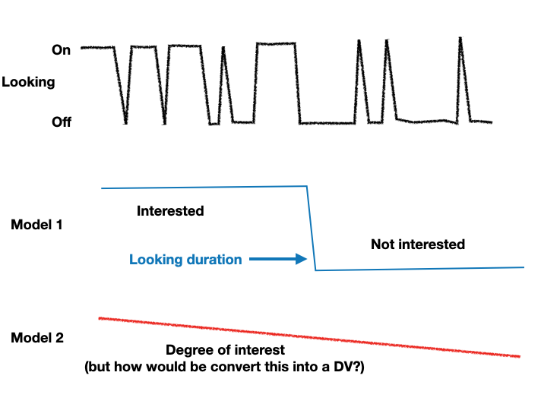
1. Does infant looking generally follow Model 1 or 2?
Notes:
Are the relative contributions predictive of other things.
There are multiple components to looking – maybe model 1 and model 2 capture different aspects of looking:
e.g. surprise is more captured by look duration, general interest is more captured my degree of interest/attentiveness

Slide 26
2. Are there individual differences in relative contributions of Model 1 vs 2?
”encoding” ?
Practical note: If we pursue this, will need to run non-infant controlled experiments?
”failure to disengage” ?
Notes:
There are multiple components to looking – maybe model 1 and model 2 capture different aspects of looking:
e.g. surprise is more captured by look duration, general interest is more captured my degree of interest/attentiveness
Is there no way to figure out whether the latent variable generating binary data is continuous or thresholded?
Separate question: is the looking that happened until lookaway criterion predictive of what happened after the criterion was reached? Can check this in 60 sec test trial from MCS ?

Slide 27
Pokebaby thought
From our last discussion: “babies don’t really compute EIG, we are just doing a rational analysis”
Rational analysis: “explain the function and purpose of cognitive processes”
e.g. “babies act rationally if what they’re trying to do is maximize EIG about a concept”.
What throws me off: Once we introduce computational limitations - in our case it’s noisy sampling, we might be mistaking rational behavior given noisy sampling for irrational behavior.
In other words: our noise parameter might absorb deviations from EIG maximization.
Notes:
Rational analysis: “explain the function and purpose of cognitive processes”

Slide 28
Thoughts about lab github/repository
Thinking about processes to make shelved or ”failed” projects available to lab members.
Common lab doc with past + present projects with links to project files, and some internal or public write-up of what happened, especially if it wasn’t published.

